Slide 1
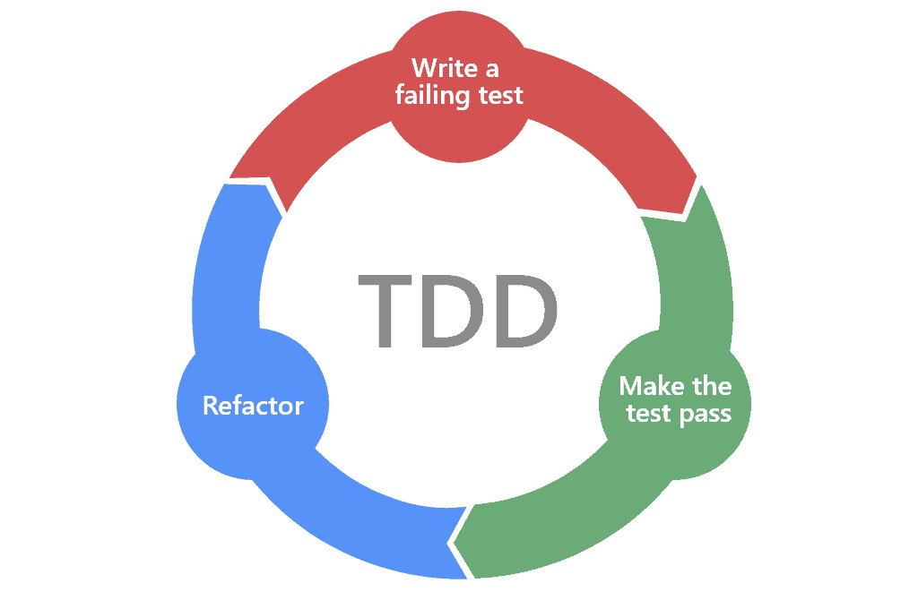

Slide 2
Ping Pong
Silent
Beginners Mind
We’ll try each style for 30/40 minutes then share what we learned at the end.

Slide 3
Ping Pong
In pairs:
A writes a new test and sees that it fails.
B implements the code needed to pass the test.
B writes the next test and sees that it fails.
A implements the code needed to pass the test.
And so on. Refactoring is done whenever the need arises by whoever is driving.

Slide 4
Silent
In pairs:
You are not allowed to talk.
All the communication is made through code.
You are not allowed to use paper or write comments in the code or other files.
Set a three minute timer and switch every three minutes.

Slide 5
Beginners Mind
In pairs:
One person is the driver and does all the coding
One person is the navigator and asks beginner, even basic and stupid questions like “what are you doing”, “why are you doing this”, “tell me what is happening in this code”
the driver is not allowed to be angry by the beginner questions of the technical coach; the driver needs to always explain what is their current idea, how they can implement it and why they chose this path.
Switch roles when were halfway through

Slide 6
The Exercise - Bank Account
You are working for a new challenger bank building their backend system.
Please implement the following features:
User can check balance
User can make a deposit to the account. A deposit has:
  Amount
  Description
  transaction type of ‘deposit’
  transaction date
User can make a withdraw from the account. A withdrawl is the same as deposit except it has:
  transaction type of ‘withdrawl’
Account can have an overdraft. If user goes over the overdraft they are fined £10. The transaction type is ‘fine’.
User can get a list of transactions.
Account pays 2% interest on savings, calculated monthly.
If you’re not sure about a requirement just make something up, but try to keep things simple. Remember, it’s just an exercise! You don’t need to worry about capital gains tax or GDRP compliance!
For simplicity, don’t worry about error cases (what if deposit amount is negative? etc).

Slide 7
The Exercise - Bank Account
Links
https://www.codecraftuk.org/events/2019/06/tdd-three-ways
https://blog.adrianbolboaca.ro/2013/10/pair-programming-game-silent-programming/
https://blog.adrianbolboaca.ro/2013/10/beginners-mind/
https://wiki.c2.com/?PairProgrammingPingPongPattern

Slide 8
The Exercise - Bank Account
You are working for a new challenger bank building their backend system.
Please implement the following features:
User can check balance
User can make a deposit to the account. A deposit has:
  Amount
  Description
  transaction type of ‘deposit’
  transaction date
User can make a withdraw from the account. A withdrawl is the same as deposit except it has:
  transaction type of ‘withdrawl’
Account can have an overdraft. If user goes over the overdraft they are fined £10. The transaction type is ‘fine’.
User can get a list of transactions.
Account pays 2% interest on savings, calculated monthly.
If you’re not sure about a requirement just make something up, but try to keep things simple. Remember, it’s just an exercise! You don’t need to worry about capital gains tax or GDRP compliance!
For simplicity, don’t worry about error cases (what if deposit amount is negative? etc).

Slide 9
The Exercise - Bank Account
You are working for a new challenger bank building their backend system.
Please implement the following features:
User can check balance
User can make a deposit to the account. A deposit has:
  Amount
  Description
  transaction type of ‘deposit’
  transaction date
User can make a withdraw from the account. A withdrawl is the same as deposit except it has:
  transaction type of ‘withdrawl’
Account can have an overdraft. If user goes over the overdraft they are fined £10. The transaction type is ‘fine’.
User can get a list of transactions.
Account pays 2% interest on savings, calculated monthly.
If you’re not sure about a requirement just make something up, but try to keep things simple. Remember, it’s just an exercise! You don’t need to worry about capital gains tax or GDRP compliance!
For simplicity, don’t worry about error cases (what if deposit amount is negative? etc).

Slide 10
The Exercise - Bank Account
You are working for a new challenger bank building their backend system.
Please implement the following features:
User can check balance
User can make a deposit to the account. A deposit has:
  Amount
  Description
  transaction type of ‘deposit’
  transaction date
User can make a withdraw from the account. A withdrawl is the same as deposit except it has:
  transaction type of ‘withdrawl’
Account can have an overdraft. If user goes over the overdraft they are fined £10. The transaction type is ‘fine’.
User can get a list of transactions.
Account pays 2% interest on savings, calculated monthly.
If you’re not sure about a requirement just make something up, but try to keep things simple. Remember, it’s just an exercise! You don’t need to worry about capital gains tax or GDRP compliance!
For simplicity, don’t worry about error cases (what if deposit amount is negative? etc).

